Slide 1


MTN.NIX
Zabbix
Monitoring System
(v3.2)
Items
Author: Siarhei Beliakou
email: siarhei_beliakou@epam.com
2017

Slide 2

Agenda
Items
Logs Monitoring
Simple checks
Calculated Items
Internal Checks
Aggregate Checks

Slide 3
Log file monitoring

Slide 4
Log file monitoring
Zabbix can be used for centralized monitoring and analysis of log files with/without log rotation support.
Notifications can be used to warn users when a log file contains certain strings or string patterns.
To monitor a log file you must have:
Zabbix agent running on the host
log monitoring item set up
https://www.zabbix.com/documentation/3.2/manual/config/items/itemtypes/log_items

Slide 5
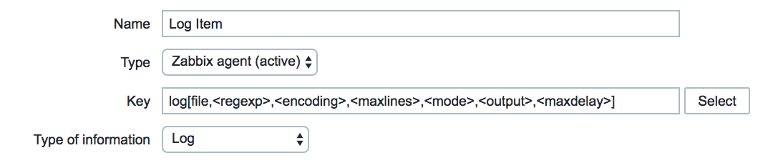
Log file monitoring
Verify agent parameters
Make sure that in the agent configuration file (/etc/zabbix/zabbix_agentd.conf):
'Hostname' parameter matches the host name in the frontend
Servers in the 'ServerActive' parameter are specified for the processing of active checks
Item configuration
Configure a log monitoring item:

Slide 6
Log file monitoring
Specifically for log monitoring items you enter:
Type | Select Zabbix agent (active) here.
Key | Set either: log[/path/to/file/file_name,<regexp>,<encoding>,<maxlines>,<mode>,<output>,<maxdelay>] or logrt[/path/to/file/regexp_describing_filename_pattern,<regexp>,<encoding>,<maxlines>,<mode>,<output>,<maxdelay>] Zabbix agent will filter entries of the log file by the content regexp, if present. If only number of matching lines is required set either: log.count[/path/to/file/file_name,<regexp>,<encoding>,<maxproclines>,<mode>,<maxdelay>] or logrt.count[/path/to/file/regexp_describing_filename_pattern,<regexp>,<encoding>,<maxproclines>,<mode>,<maxdelay>].
Type of information | Select Log for log and logrt items or Numeric (unsigned) for log.count and logrt.count items here. If optionally using the output parameter, you may select the appropriate type of information other than “Log”. Note that choosing a non-Log type of information will lead to the loss of local timestamp.

Slide 7
Log file monitoring
Specifically for log monitoring items you enter:
Type | Select Zabbix agent (active) here.
Update interval (in sec) | The parameter defines how often Zabbix agent will check for any changes in the log file. Setting it to 1 second will make sure that you get new records as soon as possible.
Log time format | In this field you may optionally specify the pattern for parsing the log line timestamp. If left blank the timestamp will not be parsed. Supported placeholders: * y: Year (0001-9999) * M: Month (01-12) * d: Day (01-31) * h: Hour (00-23) * m: Minute (00-59) * s: Second (00-59) For example, consider the following line from the Zabbix agent log file: “ 23480:20100328:154718.045 Zabbix agent started. Zabbix 1.8.2 (revision 11211).” It begins with six character positions for PID, followed by date, time, and the rest of the line. Log time format for this line would be “pppppp:yyyyMMdd:hhmmss”. Note that “p” and “:” chars are just placeholders and can be anything but “yMdhms”.
Notes:
https://www.zabbix.com/documentation/3.2/manual/config/items/itemtypes/log_items

Slide 8
Log file monitoring
should allow returning the entry count as found in the content of:
The reason why Zabbix will return only the number is because 'output' here is defined by \1 referring to the first and only subgroup of interest: ([0-9]+)
log[/path/to/the/file,"large result buffer allocation.*Entries: ([0-9]+)",,,,\1]
Fr Feb 07 2014 11:07:36.6690 */ Thread Id 1400 (GLEWF) large result buffer allocation - /Length: 437136/Entries: 5948/Client Ver: >=10/RPC ID: 41726453/User: AUser/Form: CFG:ServiceLevelAgreement

Slide 9
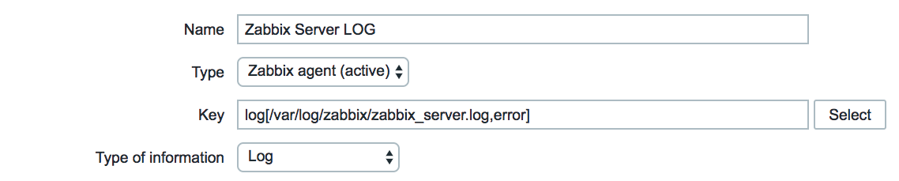
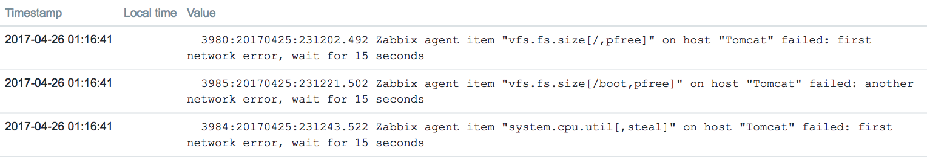
Log file monitoring

Slide 10
Simple checks

Slide 11
Simple checks
Simple checks are normally used for remote agent-less checks of services.
Note that Zabbix agent is not needed for simple checks.
Zabbix server/proxy is responsible for the processing of simple checks (making external connections, etc).
Examples of using simple checks:
net.tcp.service[ftp,,155]
net.tcp.service[http]
net.tcp.service.perf[http,,8080]
net.udp.service.perf[ntp]
More details:
https://www.zabbix.com/documentation/3.2/manual/config/items/itemtypes/simple_checks

Slide 12
Calculated items

Slide 13
Calculated items
With calculated items you can create calculations on the basis of other items.
Thus, calculated items are a way of creating virtual data sources. The values will be periodically calculated based on an arithmetical expression. All calculations are done by the Zabbix server - nothing related to calculated items is performed on Zabbix agents or proxies.
The resulting data will be stored in the Zabbix database as for any other item - this means storing both history and trend values for fast graph generation. Calculated items may be used in trigger expressions, referenced by macros or other entities same as any other item type.
To use calculated items, choose the item type Calculated.
The correct syntax of a simple formula is:
func(<key>|<hostname:key>,<parameter1>,<parameter2>,...)
Example
Calculating percentage of free disk space on '/'.
100*last("vfs.fs.size[/,free]")/last("vfs.fs.size[/,total]")
https://www.zabbix.com/documentation/3.2/manual/config/items/itemtypes/calculated

Slide 14
Internal checks

Slide 15
Internal checks
Internal checks allow to monitor the internal processes of Zabbix. In other words, you can monitor what goes on with Zabbix server or Zabbix proxy.
Internal checks are calculated:
on Zabbix server - if the host is monitored by server
on Zabbix proxy - if the host is monitored by proxy
Internal checks are processed by server or proxy regardless of host maintenance status (since Zabbix 2.4.0).
To use this item, choose the Zabbix internal item type.
Examples:
zabbix[hosts]
zabbix[host,,items]
zabbix[items_unsupported]
zabbix[java,,<param>]
zabbix[triggers]
zabbix[queue,<from>,<to>]
https://www.zabbix.com/documentation/3.2/manual/config/items/itemtypes/internal

Slide 16
Aggregate checks

Slide 17
Aggregate checks
In aggregate checks Zabbix server collects aggregate information from items by doing direct database queries.
Aggregate checks do not require any agent running on the host being monitored.
Syntax:
groupfunc["host group","item key",itemfunc,timeperiod]
Supported group functions (groupfunc) are:
Example: Total disk space of host group 'MySQL Servers'.
grpsum["MySQL Servers","vfs.fs.size[/,total]",last]
https://www.zabbix.com/documentation/3.2/manual/config/items/itemtypes/aggregate
Group function | Description
grpavg | Average value
grpmax | Maximum value
grpmin | Minimum value
grpsum | Sum of values

Slide 18
External checks

Slide 19
External checks
External check is a check executed by Zabbix server by running a shell script or a binary.
External checks do not require any agent running on a host being monitored.
The syntax of the item key is:
script[<parameter1>,<parameter2>,...]
Zabbix looks for these scripts in “ExternalScripts” directory configured in zabbix_server.conf.
Default:
ExternalScripts=/usr/lib/zabbix/externalscripts
Example:
check_oracle.sh["-h","{HOST.CONN}"]
https://www.zabbix.com/documentation/3.2/manual/config/items/itemtypes/external

Slide 20
HOmework

Slide 21
Homework
Task:
Create item and develop custom trigger for log monitoring (you can use httpd or tomcat logs)
Create a trigger for errors in log file monitored by that item

Slide 22
Homework
Assuming we have 2 servers (VMs) – ZabbixServer and Tomcat,
Configure:
Simple checks:
Zabbix Server WEB availability (80)
Zabbix DB is available (3306)
Tomcat availability (80, 8080)
Tomcat Server is available by ssh (22)
Calculated Checks:
CPU Load per Core (1, 5, 15min)
Internal Checks:
How many items are enabled
How many Servers are being monitored
Create triggers for every check

Slide 23
MTN.NIX
Thanks for Your Attention!
Questions?
Siarhei Beliakou
2017

